Slide 1
Systematic Review of
Signaling to Others
BADM 504
2023.12.04.
Bee Shin

Slide 2
Signaling in Appearance-related Products
Use of appearance-related products to signal others have different purposes. (Korichi et al. 2008; Scott, Mende, and Bolton 2013)
Cope with self-image, emotion, and mood
Seduction or camouflage
Signaling status (e.g., competence, warmth, etc.)
Signaling can be examined from different perspectives.
Sender or Receiver
Gender
Consumer relationships with brand
Implies an interaction between brands and consumers.
Consumers using products to signal.
Introduction | Selection Criteria | Analysis | Future Research

Slide 3
Research Question
What are the drivers and outcomes of appearance-related product consumption?
Introduction | Selection Criteria | Analysis | Future Research

Slide 4
Paper Selection Criteria
Key words/title searching: Signaling
Additional search
Luxury consumption
Conspicuous consumption
Makeup
Journal selection - ABS Journal Ranking
Journal of Consumer Psychology
Journal of Consumer Research
Journal of Marketing
Journal of Marketing Research
Published after 2000
+
Recently published papers (post-2020)
Cited more than 50 times
Introduction | Selection Criteria | Analysis | Future Research

Slide 5
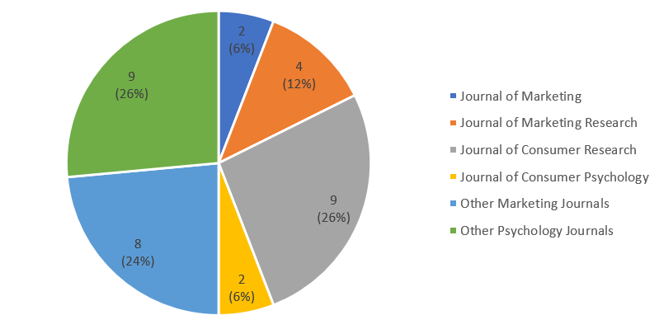
Journal Distribution
Total: 34 papers
In Marketing
Journal of Consumer Research
Journal of Marketing Research
Journal of Marketing & Journal of Consumer Psychology
Other Marketing Journals
Other Psychology Journals
Introduction | Selection Criteria | Analysis | Future Research

Slide 6
Theories
 | Mating | Social Interaction | Emotion | Impression Management/ Status | Moral Values | Authenticity
Makeup | Wu et al. (2023); Batres et al. (2018) | Aguinaldo and Peissig (2021) |  | Smith et al. (2022); Mittal and Silvera (2020) |  | Smith, Vandellen, and Ton (2021)
Luxury Consumption | Chen, Wang, and Ordabayeva (2023) | Gong, Zhang, and Zhang (2022) | Amatulli et al. (2020); Moreau et al. (2020); Pozharliev et al. (2015) | Lee and Bolton (2020); Kim, Park, and Dubois (2018); Han, Nunes, and Dreze (2010); Wong, Brodowsky, and Ho (2023); Desmichel, Ordabayeva, and Kocher (2020); Cannon and Rucker (2019) | Lee, Baumgartner, and Winterich (2018) | Goor et al. (2020)
Conspicuous Consumption | Sundie et al. (2020); Wang and Griskevicius (2014); Friskevicius et al. (2007) | Scott, Mende, and Bolton (2013) |  | Ho, Wong, and Brodowsky (2023); Lee, Ko, and Megehee (2015); Berger and Ward (2010) | Goenka and Thomas (2020)
Vintage Consumption |  |  | Sarial-Abi et al. (2017)
Status Consumption | Otterbring et al. (2018) | Bellezza, Gino, and Keinan (2014); Garcia, Weaver, and Chen (2019) |  | Gao, Winterich, and Zhang (2016)
Signaling |  |  |  | Bellezza and Berger (2020)
Political ideology |  |  |  | Ordabayeva and Fernandes (2018)
Introduction | Selection Criteria | Analysis | Future Research

Slide 7
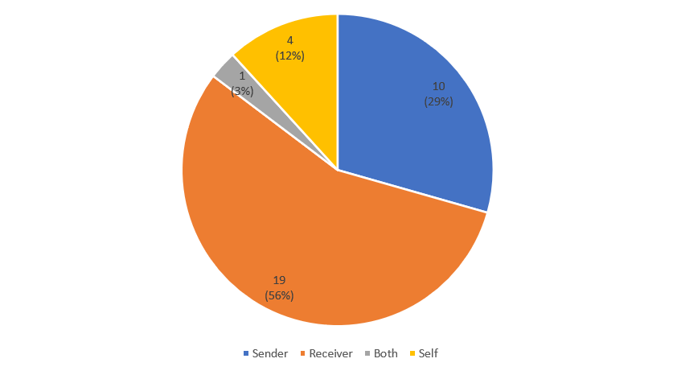
Perspectives
Introduction | Selection Criteria | Analysis | Future Research

Slide 8
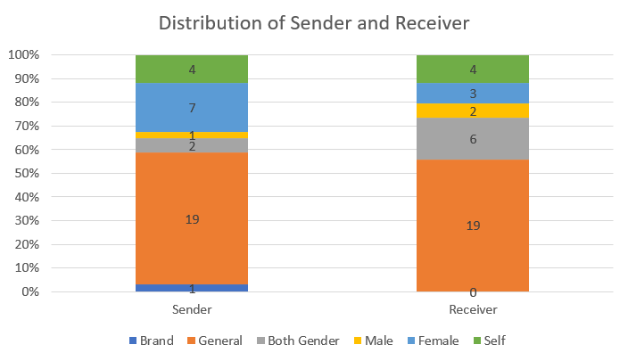
Sender and Receiver Distribution
Introduction | Selection Criteria | Analysis | Future Research

Slide 9
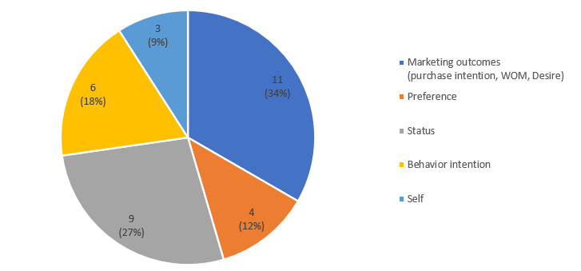
Dependent Variables
Marketing outcomes
Preference
Status
Behavior intention
Self
Introduction | Selection Criteria | Analysis | Future Research

Slide 10
Drivers in Appearance-related Product Domains
Appearance-related products
Self
Female
Male
Both gender
Brand
General
Emotion
Mating goals
Status
Self-presentation
Brand signature (Freedom)
Status
Self-authenticity
Desire
Mating goals
Moral values
Status
Desire
Introduction | Selection Criteria | Analysis | Future Research

Slide 11
Future Research
Product types
Luxury, status, and makeup products were studied.
No distinction between appearance-related products and non-appearance-related products.
Ex) Food consumption and handbags were examined in the same paper.
Effect of gender
Some studies found gender-specific effects in signaling. (Batres et al. 2018; Griskevicius et al. 2007; Otterbring et al. 2018)
However, the majority focused on non-gender-specific contexts.
Effect direction
Many studies involving appearance-related products found a negative association between product usage and dependent measures.
Positive association could be studied.
Belonging, in-group vs. out-group, etc.
Introduction | Selection Criteria | Analysis | Future Research

Slide 12
Thank You!

